Slide 1

Sync+ 2.0 { CD542H_R08 RPO HF} –{Desay}_EESE&CVPP parts
China EESE&CVPP
Updated on 2021-09-13
Desired Outcome
Awareness
Decision
Escalation Help
Think
Point of view
Plan to Implement
Implement

Slide 2
{R08 PRO HF1} Software overall status {yellow}
Software key info
  Refer SWAD for the details:
    MCU version:20210903_266_PRO
    SoC version:20210907_0483_B1F27_R08.PRO_User
  Verification scope and method:
    {Full verification} executed with pass rate 96.09%, 7 P1 and 242 P2 issues found and not fixed. Refer test report for detail.
Main changes compared with previous version, refer RN for the details, highlights listed below:
    Non-compliance issue list, refer attached file for detail, P1 issues listed below:
    Open P1 issue list with risk evaluation – refer slide 4/5
    Open AIMS with risk evaluation – refer slide 6
    Open P2 issue list with risk evaluation – refer attached file
Notes:
Add P1 weekly burn down chart

Slide 3
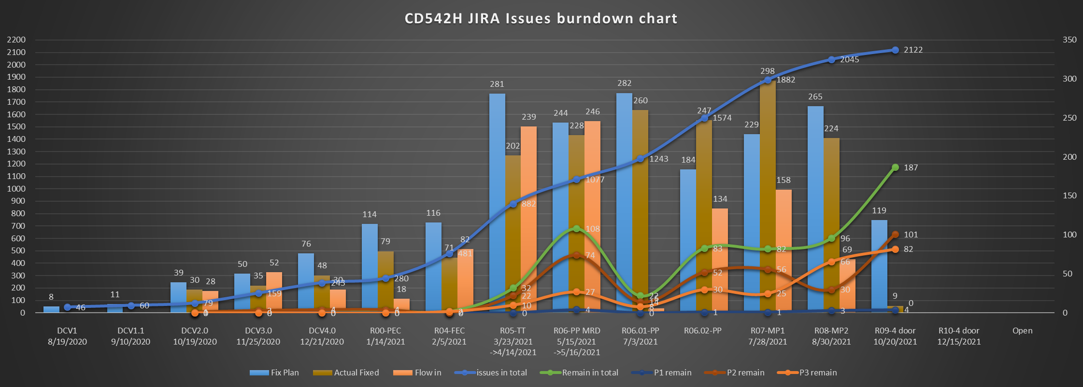
{CD542_R08 PRO HF1} burndown chart by 2021-09-13
JIRA status as above
Notes:
Add P1 weekly burn down chart

Slide 4

{R08 PRO HF1} Open P1 issue list with risk evaluation
AIMS # | Key | Summary /recurrence rate, recover method, impact | Status | Supplier | Creation date | Fix Version/ with date | Root cause | Risk evaluation for {R08 PRO HF2}
 | APIMCIS-17621 【R09】 | Bug - 【重庆工厂】分屏模式下首次点击副屏导航栏会黑屏1S 100%，首次点击必现/自动恢复/用户体验 | Awaiting implementation | Desay | 2021-9-13 8:27 |  |  | M
 | APIMCIS-17358？？ | 【偶发】行驶过程中系统自动重启 偶现一次/自动重启/用户体验 | Awaiting implementation | Desay | 2021-9-9 11:37 |  |  | M
 | APIMCIS-16987 【R09】 | [CD542H]长时间行驶，多场景操作拔开ADB线出现“重启”;1-2秒后Launcher恢复，但是wifi无法开启，没有网络，CCS开关无法打开；quick ignition无法恢复 偶现一次/休眠重启/使用 | Test | Desay | 2021-9-4 16:29 | B1F27_R09.ENG | system_server重启后，路由概率性未创建引发的问题 | M
Notes:
Add P1 weekly burn down chart

Slide 5
{R08 PRO HF1} Open P1 issue list with risk evaluation
AIMS # | Key | Summary /recurrence rate, recover method, impact | Status | Supplier | Creation date | Fix Version/ with date | Root cause | Risk evaluation for Risk evaluation for {R08 PRO HF2}
无
Notes:
Add P1 weekly burn down chart

Slide 6
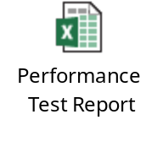
Other highlights
Performance status:

